Slide 1
交接文件
AID

Slide 2
AID 相關

Slide 3
AID System
User
Service

Slide 4
AID System (Type1)
Client Application
Server Application
Wallet Lib
Service SDK

Slide 5
AID System (Type2)
AID Server
Client Application
Server Application
Wallet Lib
Service SDK

Slide 6
AID System (Type3)
Smart Contract
Client Application
Server Application
Wallet Lib
Service SDK

Slide 7
AID System (Type4)
Smart Contracts
AID Server
(大流量)
Client Application
Server Application
Wallet Lib
Service SDK

Slide 8
AID System (Type3)
Smart contract
UUID
AID
Hash
UUID
AID
Hash
UUID
AID
Hash

Slide 9
AID System (Type4)
Smart contract
Smart contract
Smart contract
UUID
UUID
UUID
AID
AID
AID
Hash
Hash
Hash
AID Server
AID Server

Slide 10
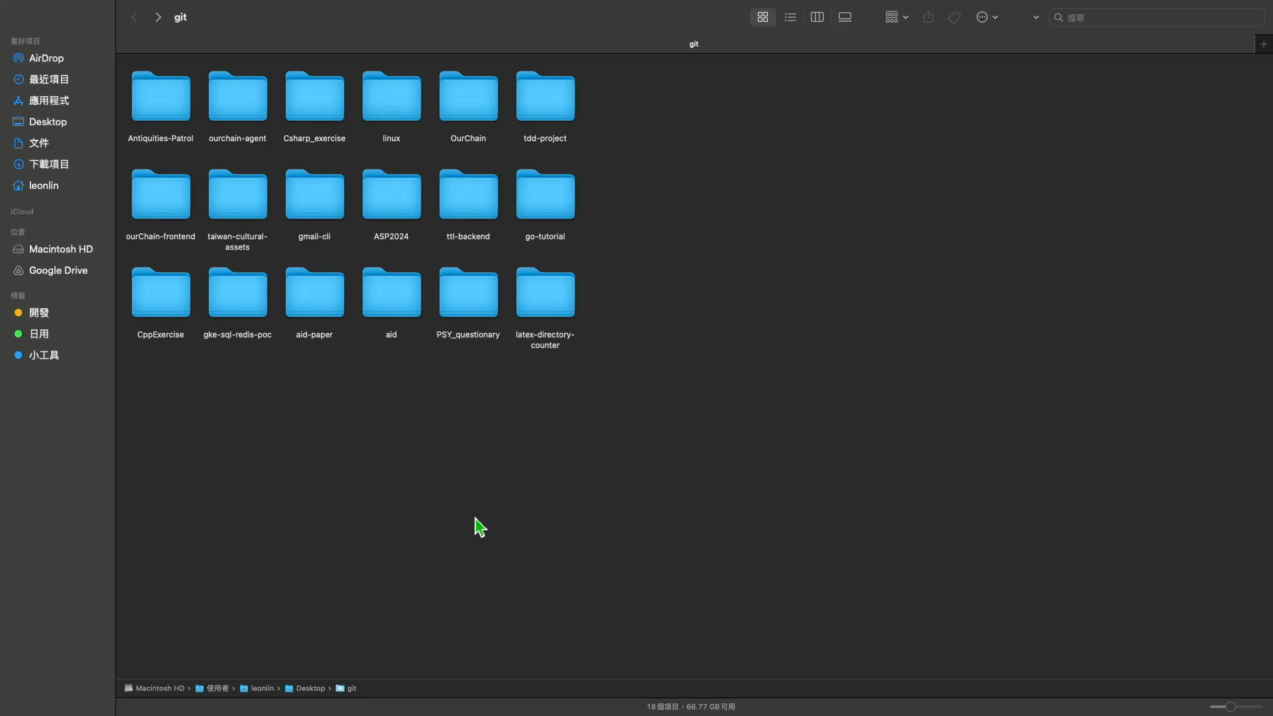
DEMO
Url: github leon123858/aid/demo/t1
Docker compose up

Slide 11
相關連結

Slide 12
OurChain 相關

Slide 13
錯誤嘗試

